Slide 1

COST
Moments- Frequency Distribution

Slide 2
Revision
Moments
1
Skewness
2
Raw Moments
Central Moments
Positively skewed
Negatively skewed
Raw Data
Frequency Distribution

Slide 3
Skewness
Skewness is a degree of asymmetry/ lack of symmetry/ departure from symmetry.
Concerns with the shape of the curve .
Two types-
Positive Skewness
Negative Skewness

Slide 4
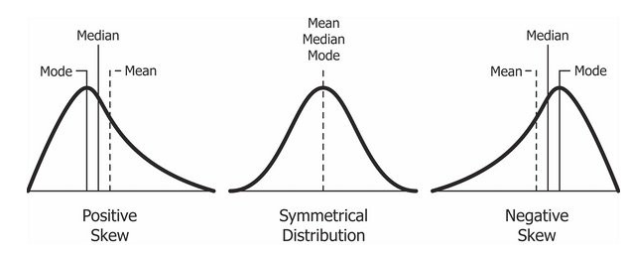
Skewness

Slide 5
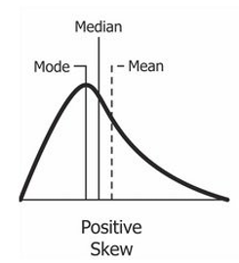
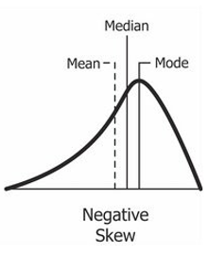
Positive Skewness
Tail on the right side of the distribution is longer.
the mass of the distribution is concentrated on the left of the figure
Mean, Median > mode.
Negative Skewness
Tail of the left side of the distribution is longer.
the mass of the distribution is concentrated on the right of the figure
Mean, Median < Mode

Slide 6
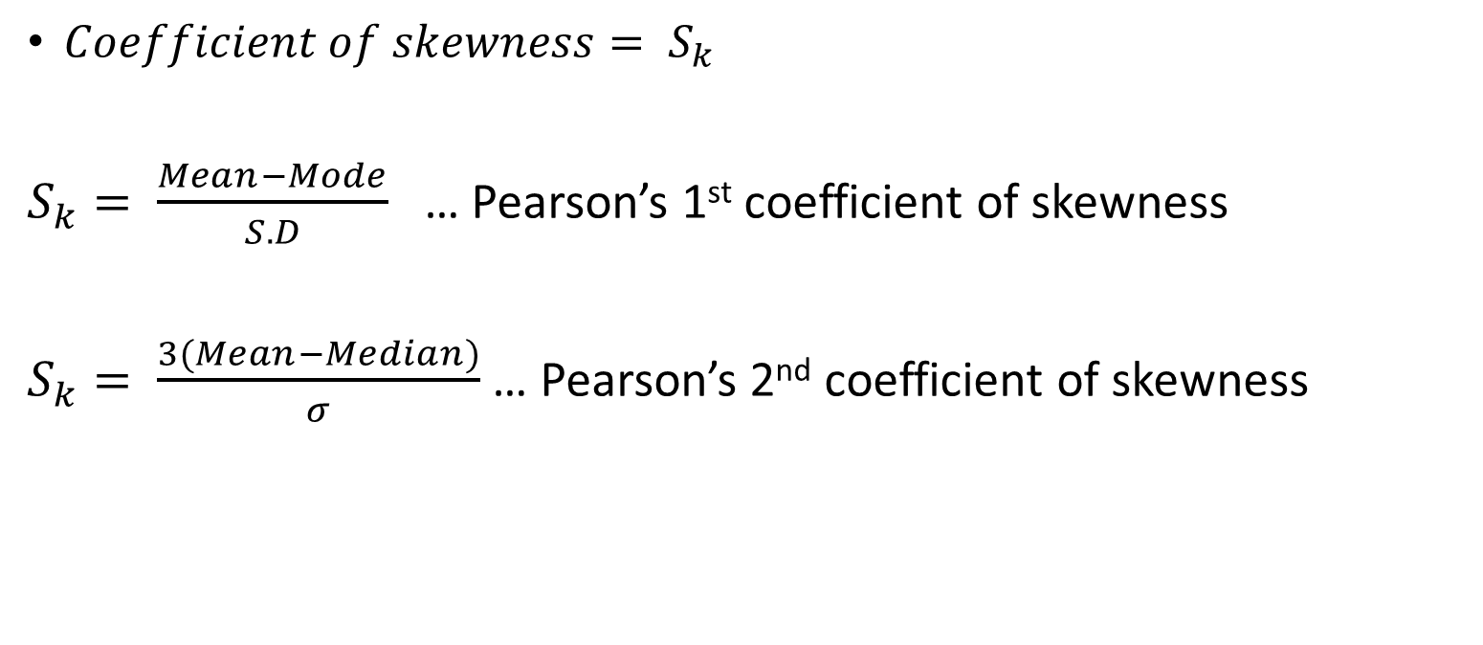
Skewness- Formulae
$Coefficient of skewness= S_{k}$
$S_{k}= \frac{Mean−Mode}{S.D}$ … Pearson’s 1st coefficient of skewness
$S_{k}= \frac{3(Mean−Median)}{σ}$ … Pearson’s 2nd coefficient of skewness

Slide 7
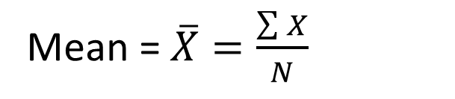
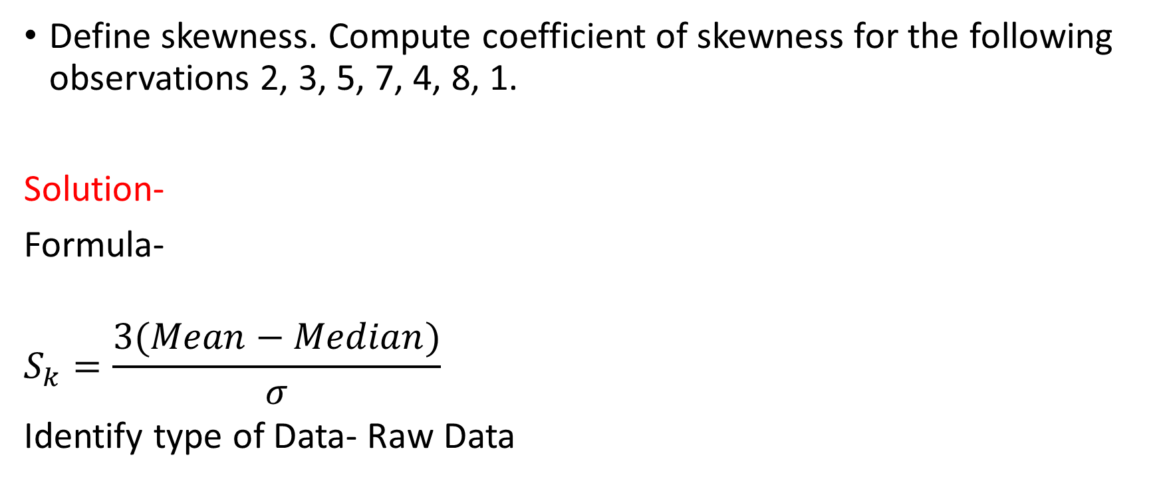
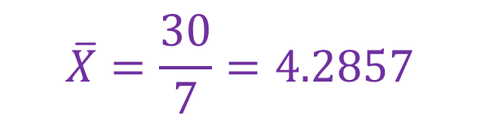
Question Nov 2018
Define skewness. Compute coefficient of skewness for the following observations 2, 3, 5, 7, 4, 8, 1.
Solution-
Formula-
$$S_{k}=\frac{3(Mean−Median)}{σ}$$
Identify type of Data- Raw Data
Mean = $\overline{X}=\frac{\sum{X}}{N}$
$$\overline{X}=\frac{30}{7}=4.2857$$
Median= Middle value of data arranged in increasing order
Median = 4

Slide 8
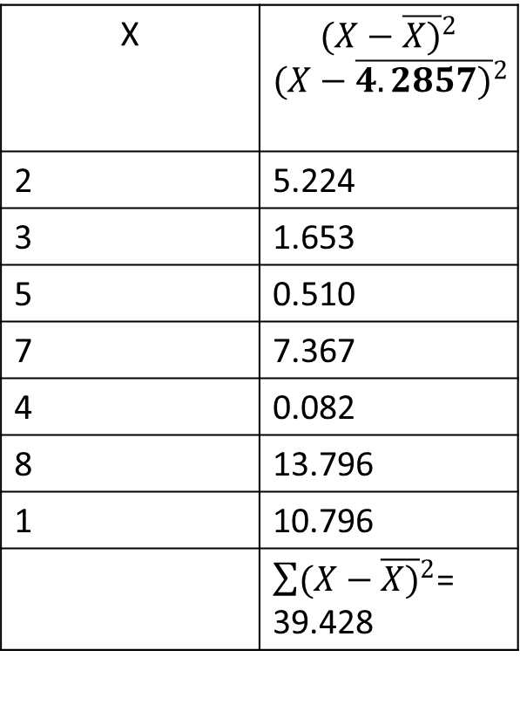



Cont…
X | $${(X−\overline{X)}}^{2}$$ $${(X−\overline{4.2857)}}^{2}$$
2 | 5.224
3 | 1.653
5 | 0.510
7 | 7.367
4 | 0.082
8 | 13.796
1 | 10.796
 | $\sum{{(X−\overline{X)}}^{2}}$= 39.428
$S.D=σ=\sqrt{\frac{\sum{{(X−\overline{X)}}^{2}}}{N}}$
$$σ=\sqrt{\frac{39.428}{7}}=2.373$$
$$S_{k}=\frac{3(Mean−Median)}{σ}$$
$$S_{k}=\frac{3(4.2857−4)}{2.373}$$
$$S_{k}=0.361$$

Slide 9
Question
Compute coefficient of skewness for the following observations-
25, 11, 16, 15, 29, 30, 33

Slide 10
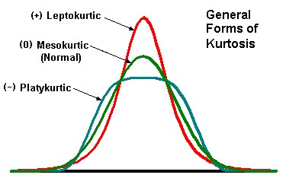
Kurtosis
The degree of “peakedness/flatness” of a distribution is known as Kurtosis.
Usually, it is taken compared to the normal distribution.
Leptokurtic- High peak- Lepto- Skinny peak- +ve kurtosis
Mesokurtic- Normal distribution curve- zero kurtosis
Platykurtic- Flat-topped- platy-broad peak- -ve kurtosis

Slide 11
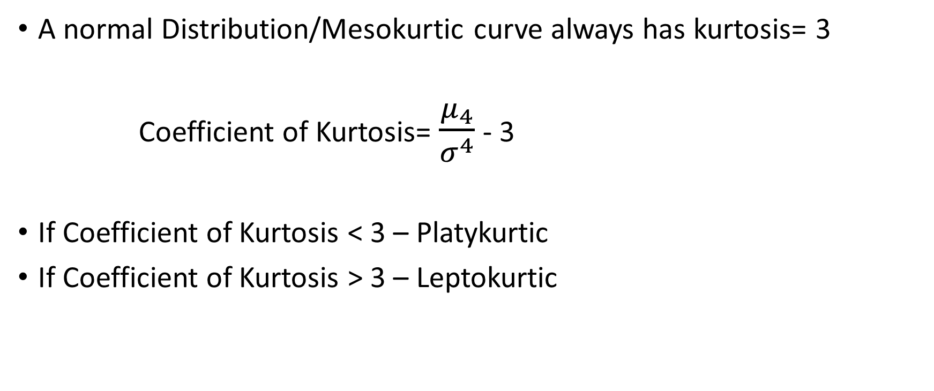
Kurtosis Formula-
A normal Distribution/Mesokurtic curve always has kurtosis= 3
Coefficient of Kurtosis= $\frac{μ_{4}}{σ^{4}}$ - 3
If Coefficient of Kurtosis < 3 – Platykurtic
If Coefficient of Kurtosis > 3 – Leptokurtic

Slide 12

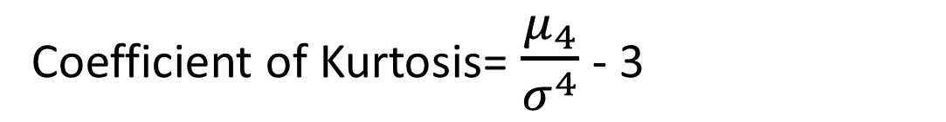
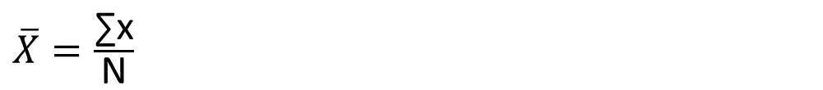

Questions
Define kurtosis. Compute coefficient of kurtosis for the following observations 2, 3, 5, 7, 4, 8, 1.
Also comment on result.
Solution-
Formula-
$$μ_{4}=\frac{\sum{{\left(X−\overline{X}\right)}^{4}}}{N}$$
$\overline{X}=\frac{\text{∑}\text{x}}{\text{N}}$
Coefficient of Kurtosis= $\frac{μ_{4}}{σ^{4}}$ - 3
$$S.D=σ=\sqrt{\frac{\sum{{(X−\overline{X)}}^{2}}}{N}}$$

Slide 13

Relation between raw moments and central moments
$μ_{1}^{′}=$ $\overline{X}$= Arithmetic Mean
$${ μ}_{1}=0$$
$${ μ}_{2}=μ_{2}^{′}−( {μ_{1}^{′})}^{2}$$
$${ μ}_{3}=μ_{3}^{′}−3 μ_{1}^{′}μ_{2}^{′}+2( {μ_{1}^{′})}^{3}$$
$${ μ}_{4}=μ_{4}^{′}−4 μ_{1}^{′}μ_{3}^{′}+6( {μ_{1}^{′})}^{2}μ_{2}^{′}−3( {μ_{1}^{′})}^{4}$$

Slide 14
Questions
If first four raw moments of a data set are 7.2, 96.4, 289.72 and 4588.36 respectively, then find first four central moments.
If first four raw moments of a data set are 5, 75, 356 and 2560 respectively, then find first four central moments.

